Slide 1
Analyzing the Neighborhoods in Chennai for Starting a Restaurant
By: Karthikeyan Viswanathan
Date: February 02, 2021

Slide 2
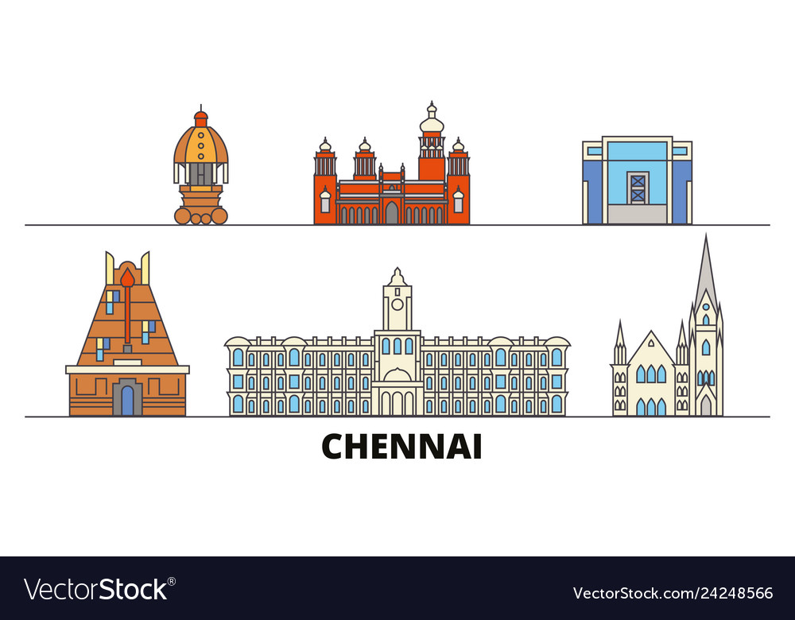
Introduction
Chennai is the Health capital of India and 36th-largest urban area by population in the world.
Chennai is among the most-visited Indian cities by foreign tourists. It was ranked the 43rd-most visited city in the world for the year 2015.
Business owners and entrepreneurs might be looking to start a new restaurant in Chennai.
The task is to identify neighborhoods that have the potential of being good locations for starting a new restaurant.
Figure 1: Chennai heritage site graphical view

Slide 3
Data Collection
The following data was collected for this project:
Neighborhood data of Chennai from https://en.wikipedia.org/wiki/List_of_neighborhoods_in_Chennai
Geographical coordinates of Chennai and all neighborhoods in Chennai using GeoPy and Geocoder libraries in python
Venue data for all neighborhoods in Chennai using Foursquare API
The data was then cleaned to produce the final datasets shown in the upcoming slides

Slide 4
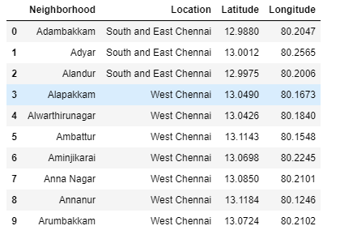
Dataset for Chennai Neighborhoods
Figure 2: First 10 rows of Chennai Neighborhood Dataframe

Slide 5
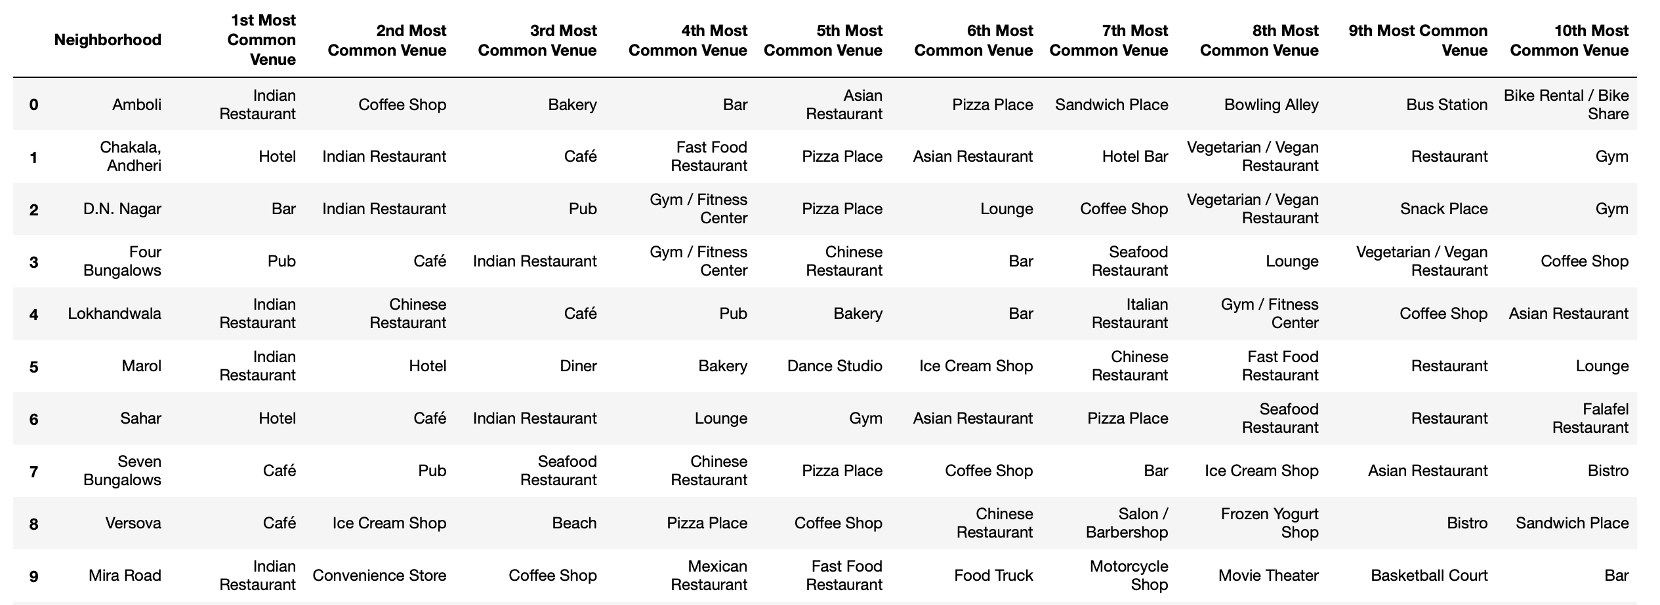
Dataset for Top 10 Most Common Venues
Figure 3: First 10 rows of top 10 most common venues for all neighborhoods

Slide 6
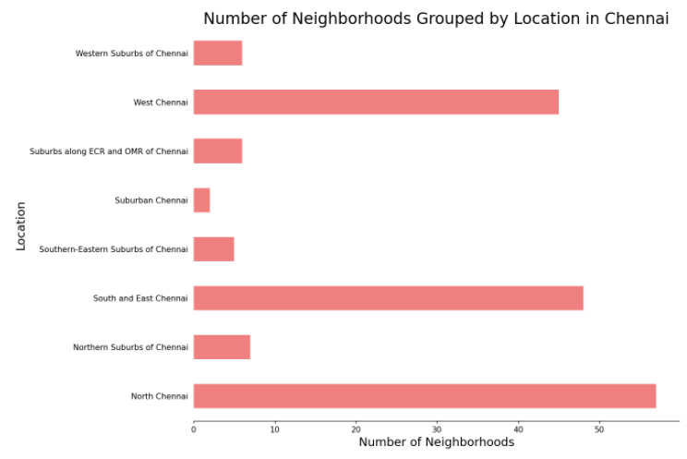
Methodology
Data Visualization
Chennai neighborhoods data was plotted for providing a better understanding
The graph alongside depicts the number of neighborhoods in each location of Chennai
All neighborhoods on the outskirts of the city have been grouped as “Chennai”
North Chennai and South East Chennai contain the highest number of neighborhoods
Figure 4: Number of neighborhoods grouped by location

Slide 7
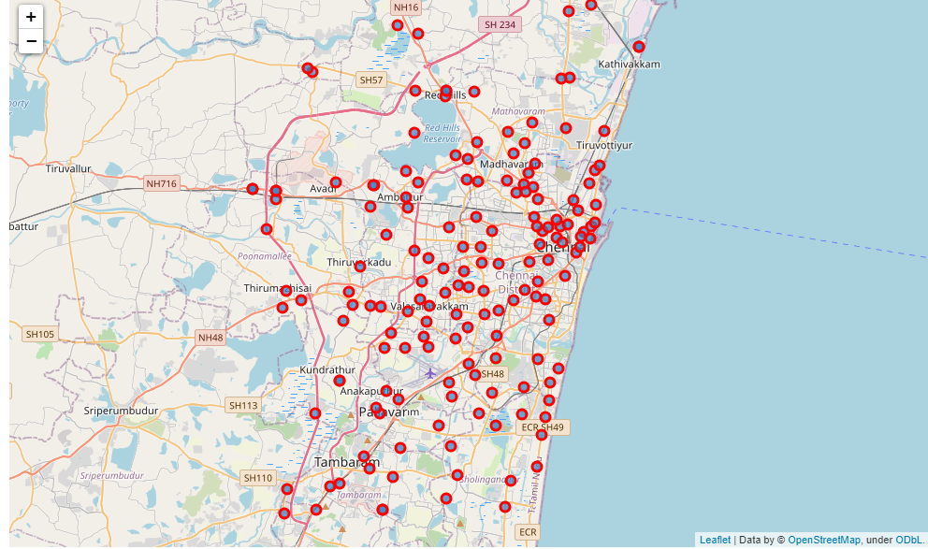
Methodology Continued
Data Visualization
The Folium library in python was used to visualize the spread of all neighborhoods across Chennai
Figure 5: The neighborhood spread across Chennai

Slide 8
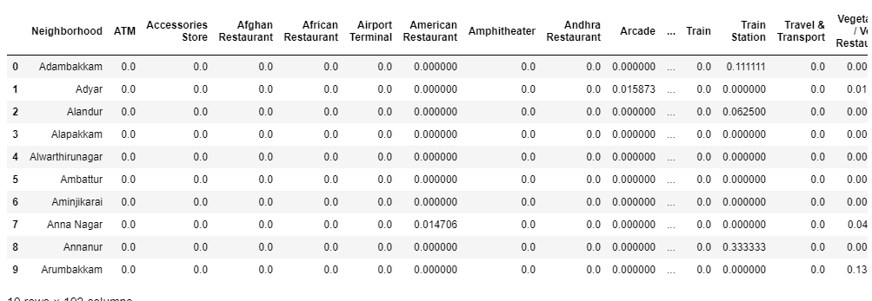
Methodology Continued
One-hot Encoding
One-hot Encoding was used to encode venue categories to numeric values with 1 if a venue belongs to a category and 0 if a venue does not belong to a category for all neighborhoods
The average is then taken for all venue categories in a neighborhood to produce the dataframe shown
Figure 6: One-hot Encoding resulting dataframe

Slide 9
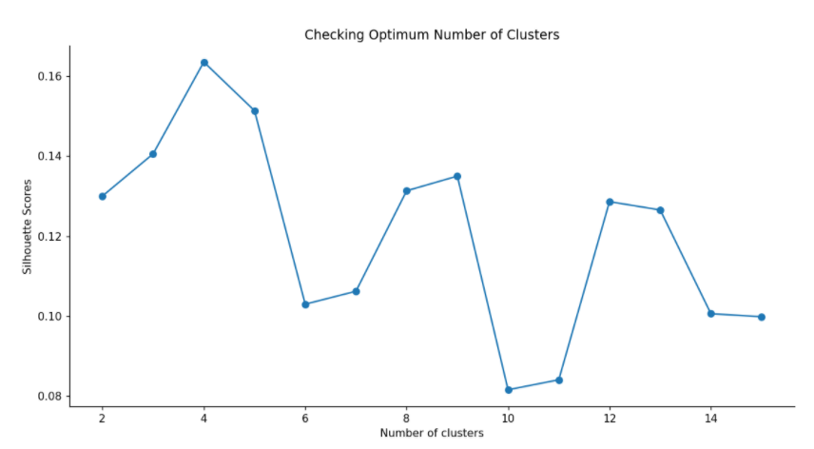
Methodology Continued
Unsupervised Learning Model
KMeans clustering was used to cluster neighborhoods in Chennai based on venue categories
The plot shows a maximum Silhouette Score for 4 clusters and thus the n_clusters parameter in KMeans clustering was set to 5
Figure 7: Silhouette scores for varying number of clusters in KMeans clustering

Slide 10
Results
Each neighborhood received a cluster label based on clustering by the KMeans algorithm
The Cluster Label column along with the Location, Latitude, and Longitude columns were added to the top 10 most common venues dataframe to provide the final results
This dataframe is shown on the next slide

Slide 11
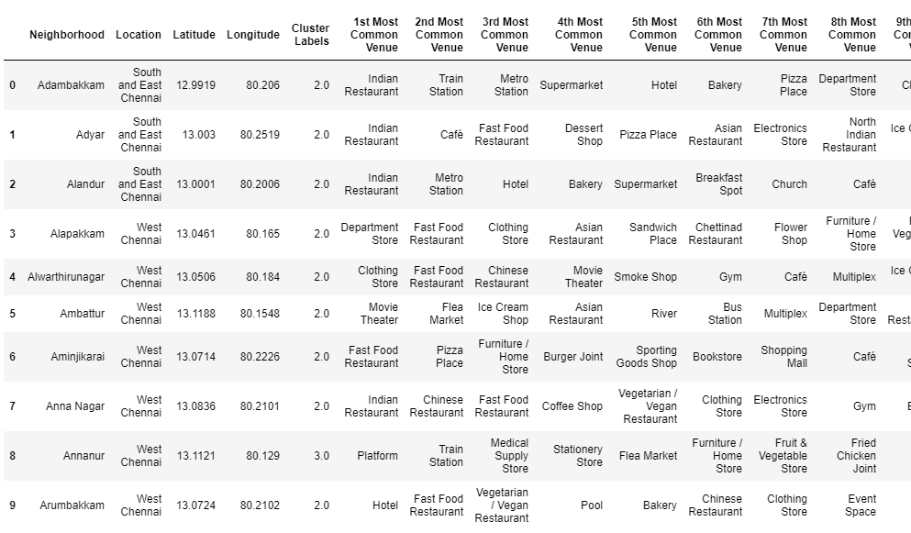
Results Continued
Figure 8: First 10 rows of clustering neighborhoods in Chennai dataframe

Slide 12
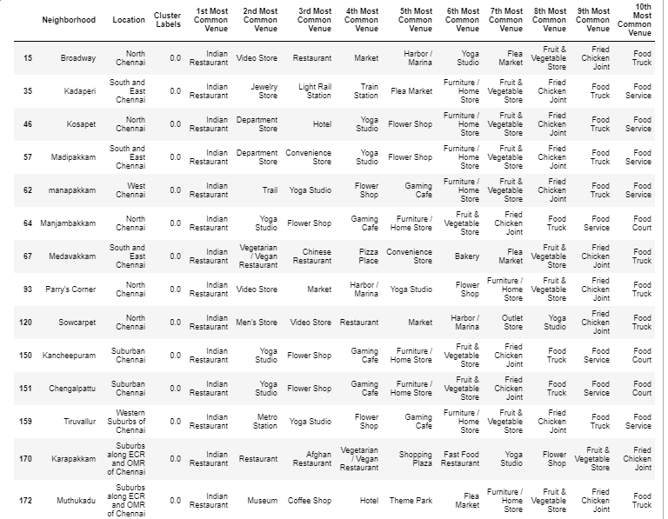
Results Continued – Cluster 1
Analyzing each cluster individually
Figure 9: Cluster 1

Slide 13
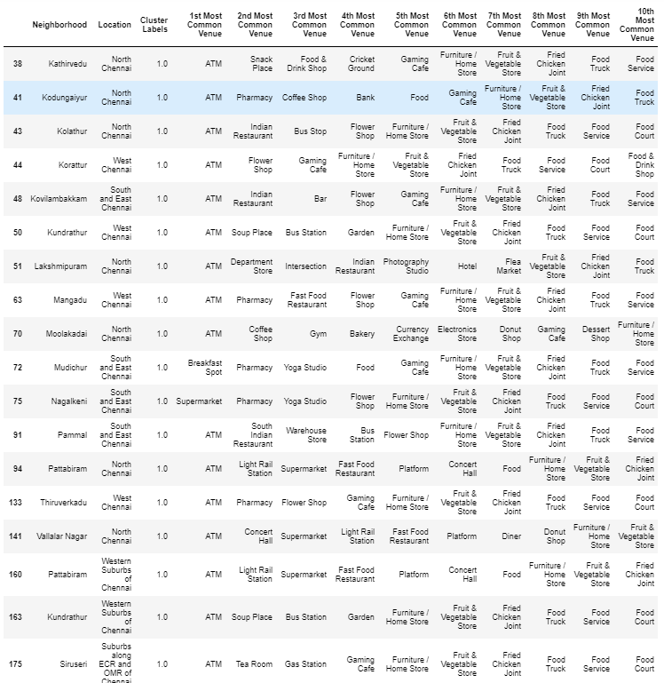
Results Continued – Cluster 2
Figure 10: Cluster 2

Slide 14
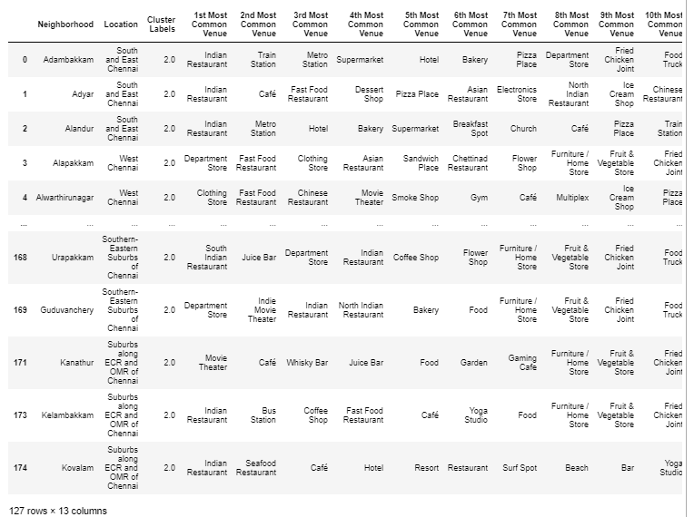
Results Continued – Cluster 3
Figure 11: Cluster 3

Slide 15
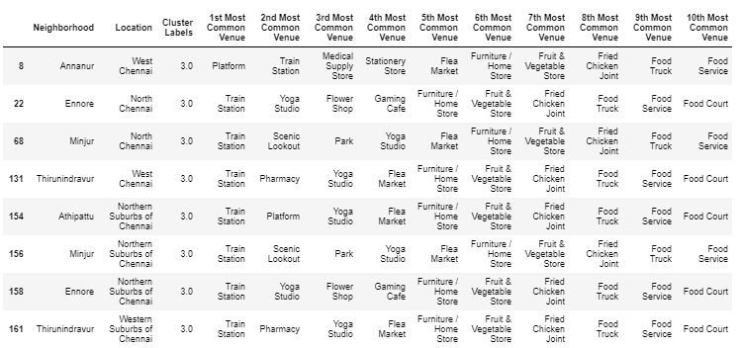
Results Continued – Cluster 4
Figure 12: Cluster 4

Slide 16
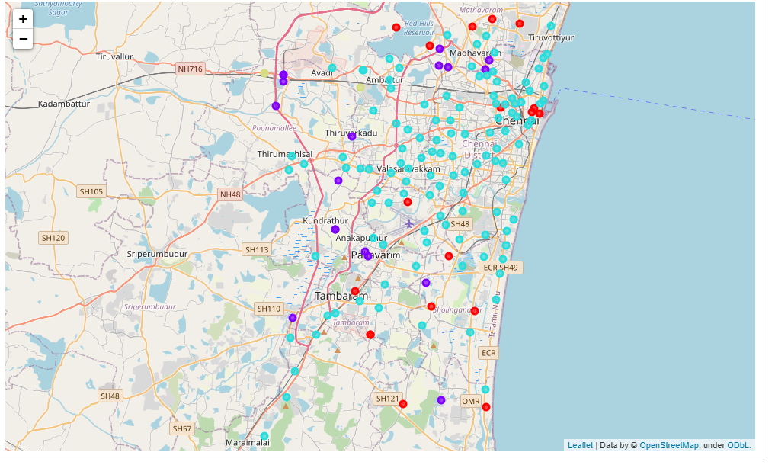
Results Continued
Visualization of neighborhood clusters was done using Folium in python
Different clusters correspond to different colors
Figure 14: Visualizing the clustering of neighborhoods in Chennai

Slide 17
Discussion
By analysing the five clusters obtained we can see that some of the clusters are more suited for restaurants and hotels, whereas, other clusters are less suited.
Neighborhoods in clusters 3, 4 contain a small percentage of restaurants, hotels, cafe and pubs in their top 10 common venues. These clusters contain a higher degree of other venues like train station, bus station, fish market, gym, performing arts venue and smoke shop, to name a few.
Thus, they are not well suited for opening a new restaurant. On the other hand, neighborhoods in clusters 1 and 2 contain a much higher degree of restaurants, hotels, multiplex, cafes, bars and other food joints.
Thus, the neighborhoods in these clusters would be well suited for opening a new restaurant.

Slide 18
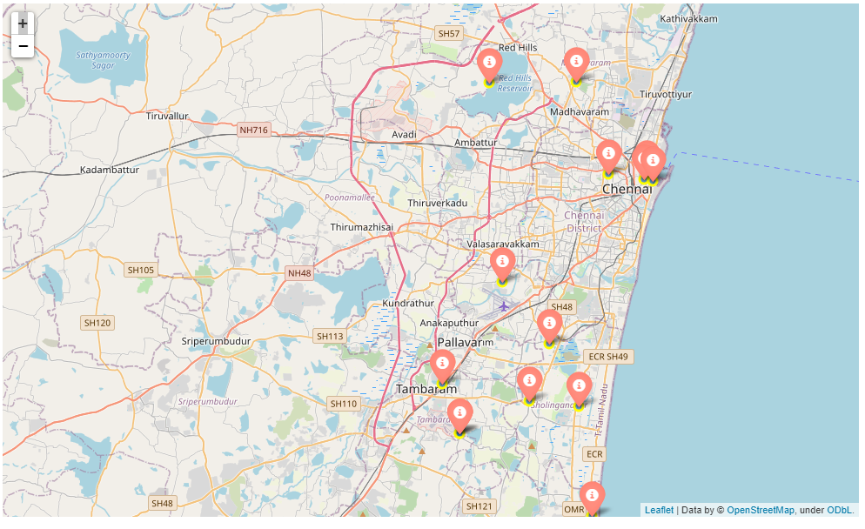
Discussion Continued
Plotting final results using Folium library in python
Figure 15: Neighborhoods in Chennai that are most suited for starting a new restaurant (Cluster 1)

Slide 19
All these places first choice of shop is Indian Restaurant .
Broadway
Kadaperi
Kosapet
Madipakkam
manapakkam
Manjambakkam
Medavakkam
Parry's Corner
Sowcarpet
Kancheepuram
Chengalpattu
Tiruvallur
Karapakkam
Muthukadu

Slide 20
Conclusion
In this project, the neighborhoods in Chennai, India have been successfully analysed for determining which would be the best neighborhoods for opening a new restaurant.
Based on the analysis carried out, neighborhoods in cluster 1 are recommended as locations for the new restaurant.
The stakeholders and investors can further tune this by considering various other factors like transport, legal requirements, and costs associated which were out of the scope for this project and thus were not considered.

Slide 21
Thank you
Github link :
https://github.com/yankarto/Coursera_Capstone/blob/main/final_project_week5/Neighborhoods%20in%20Chennai%20to%20Open%20a%20Restaurant.ipynb
IBM Cloud link : its better for MAP viewing
https://eu-gb.dataplatform.cloud.ibm.com/analytics/notebooks/v2/fe94db64-64d3-4154-8862-a39fd77dd718/view?access_token=50c7269f87cd7c18f0117087493b8b74d50dfc22fd353e4c70a207604215682b

